Slide 1
Maximum Flow
by Team #3: Cody Camp(Leader)
Ziyang Ruan
Feng Zhang

Slide 2
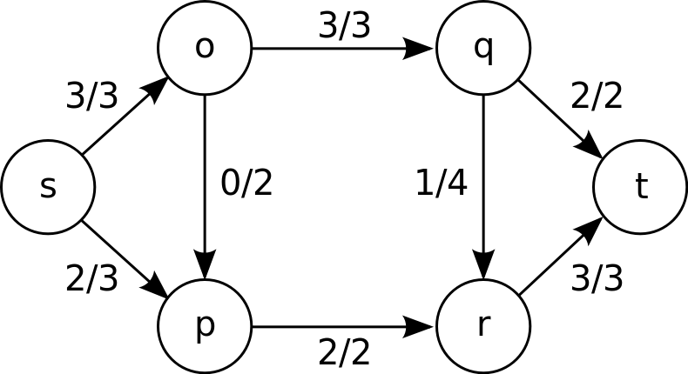
Maximum flow problems involve finding a feasible flow through a single-source, single-sink flow network that is maximum.
A flow network with an example of maximum flow

Slide 3
Example Graph Problem
(Trucking Problem)
Source
(Factory)
Sink
(warehouse)
Vertex o, p, q and r: intermediate cities

Slide 4
Ford Fulkerson Algorithm
Initialize the max flow to be zero
while there is an augmenting path
find an augmenting path using DFS
find the bottleneck in the augmenting path
for each edge u->v in the path
increase flow u->v by bottleneck
decrease capacity v->u by bottleneck
increase the max flow by bottleneck

Slide 5
What is an augmenting path?
1. Non-full forward edges
2. Non-empty backward edges

Slide 6
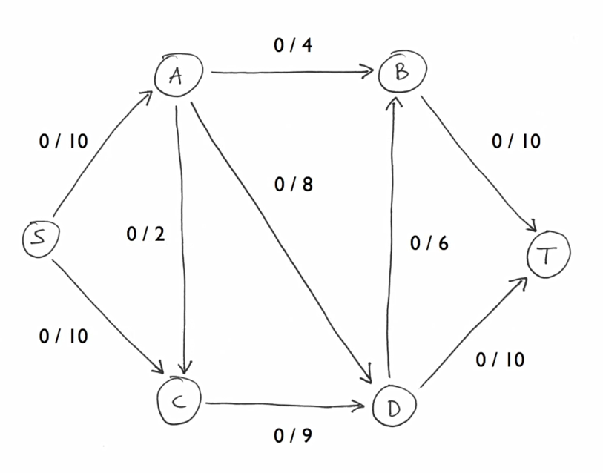

Slide 7
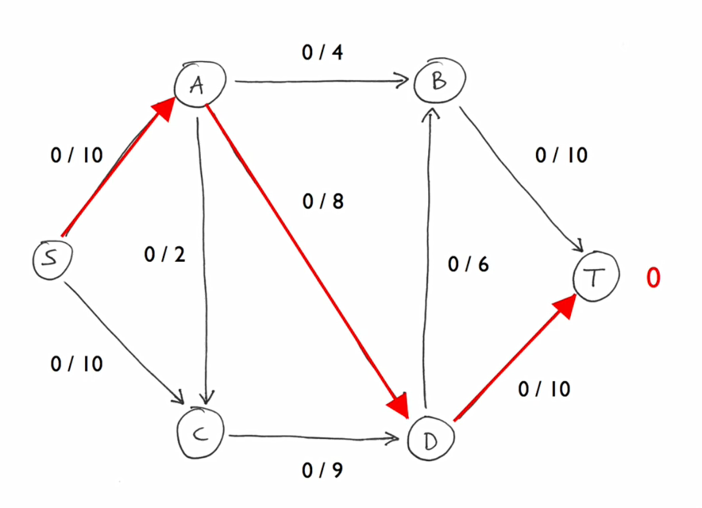

Slide 8
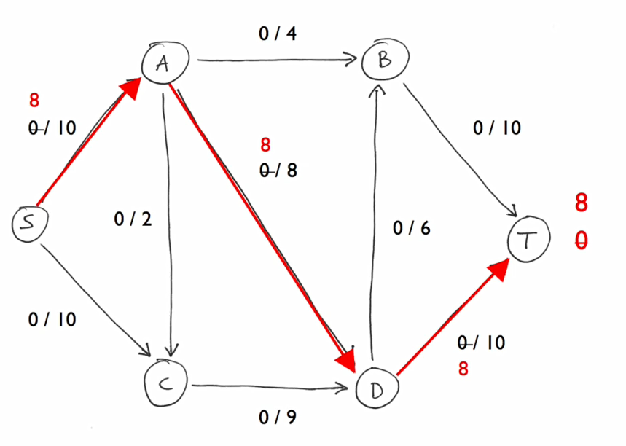

Slide 9
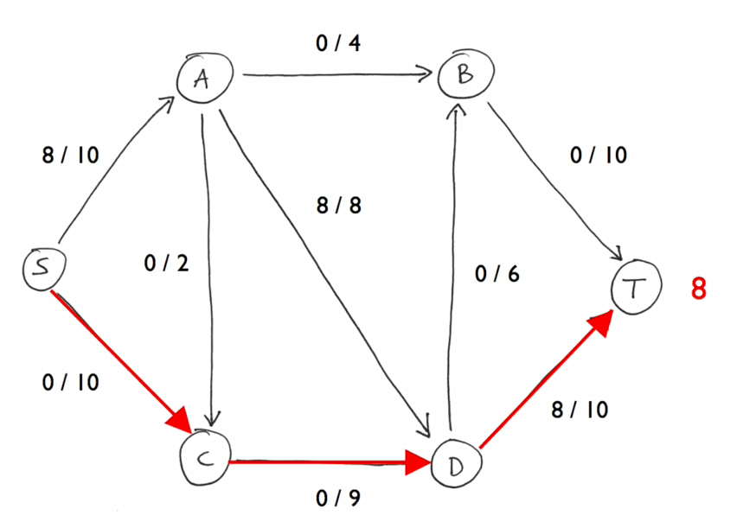

Slide 10
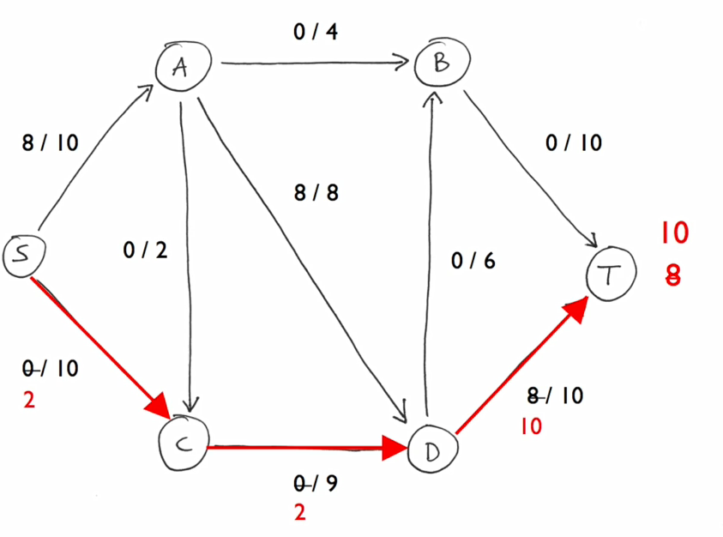

Slide 11
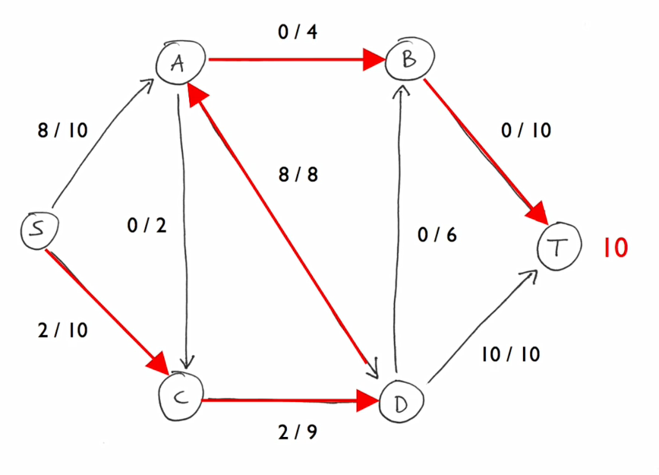

Slide 12
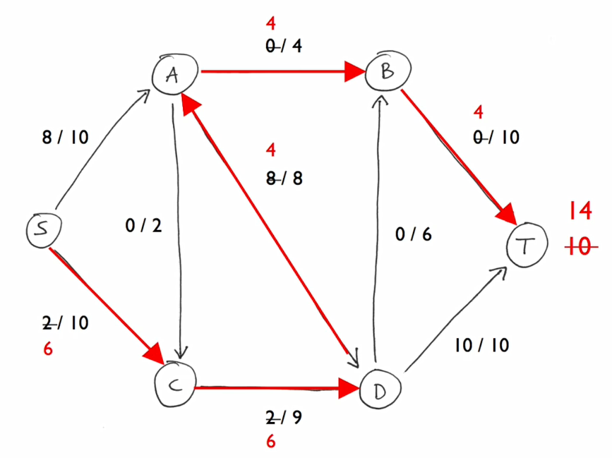

Slide 13
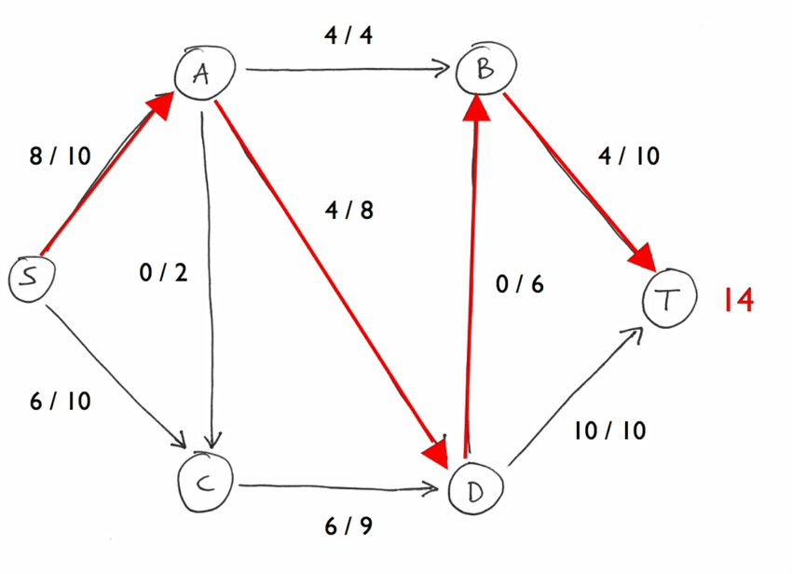

Slide 14
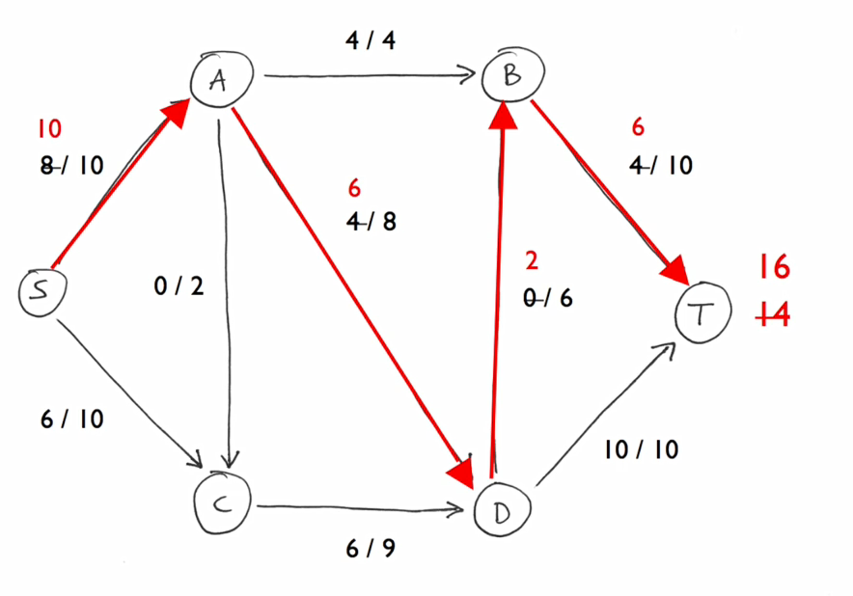

Slide 15
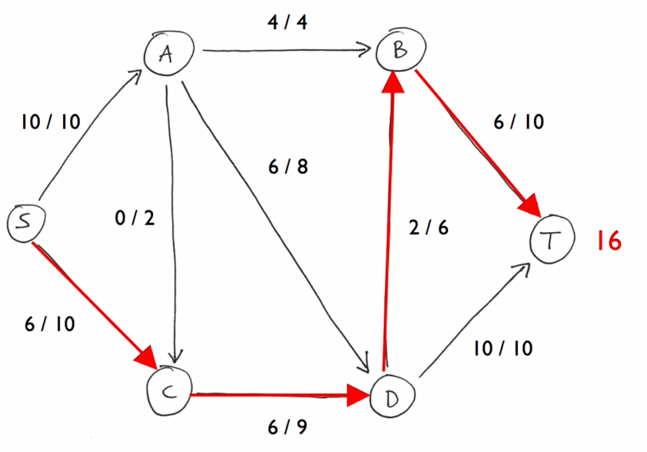

Slide 16
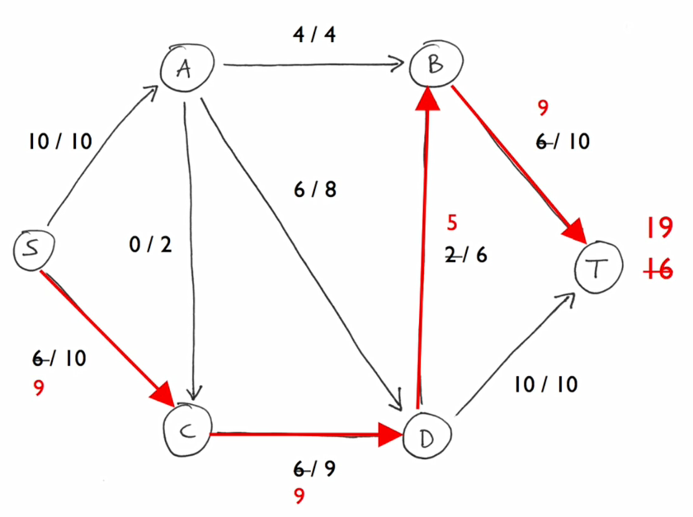

Slide 17
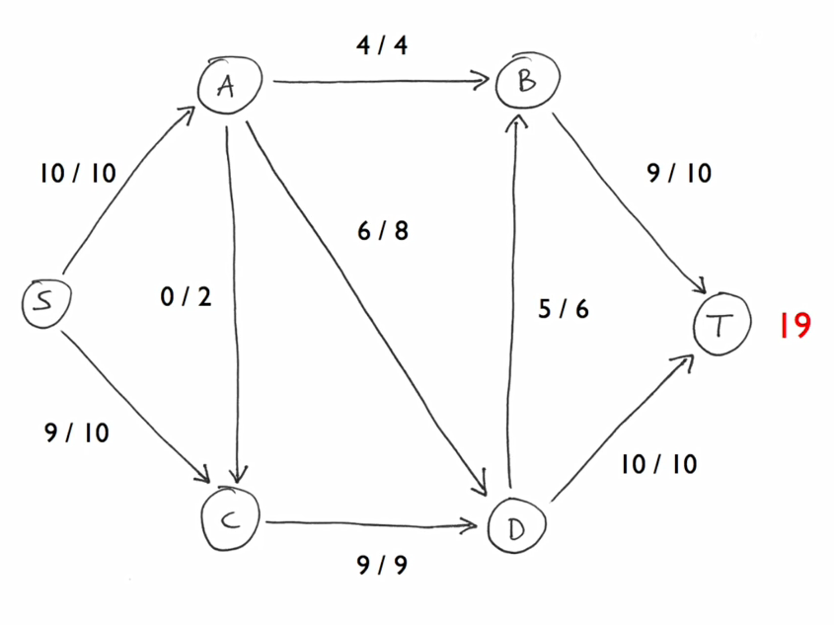

Slide 18
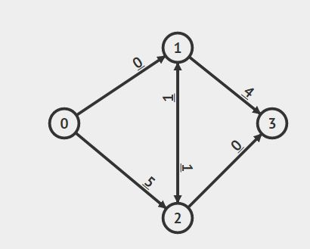
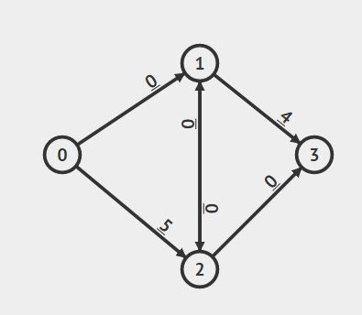
HAND
COMPUTER

Slide 19
Thank You

